Slide 1
Fundamentals
SOFTWARE QUALITY ASSURANCE (SQA)

Slide 2
What you will learn Today
Introduction
Shifting our testing to left before the code is written
Learning to analyze the requirements and write tests
Build traceability between requirements and test cases
Explore different testing levels, types and methodologies

Slide 3
Table of Content
Introduction
Requirement and their Validation
Shifting Left
Requirements
Static Testing of Requirements
Requirements as Basis of Test Cases
Mapping and Traceability
Testing Levels
Testing Types
Testing Methodologies in Agile

Slide 4
Revist Last Lab

Slide 5
Requirements and their validation

Slide 6
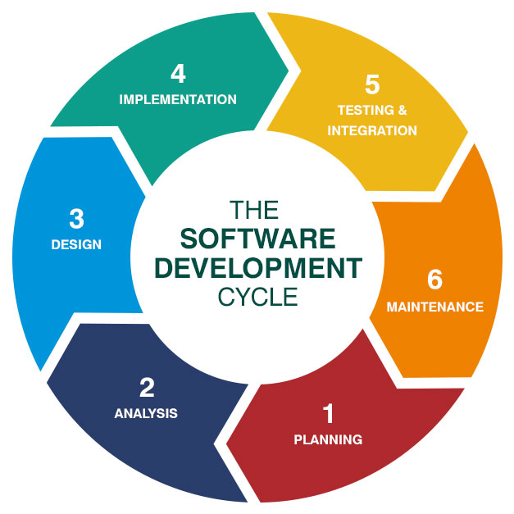
Shifting Left
We have been testing after Impelementation
Is it the right thing to do?

Slide 7
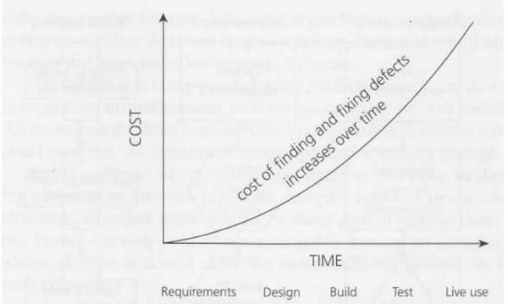
Shifting Left
Cost of finding and fixing bugs after build is high
So We need to Shift left and test early

Slide 8
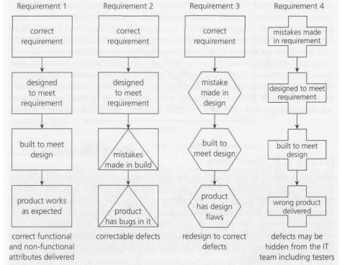
Mistake in requirements may even stay hidden
Requirements Specifications

Slide 9
Requirements specify what the software will become
Requirements Specifications

Slide 10
Requirements Specifications
1. WHO * Who will manage or use the application? – Roles | 2. WHAT * What are the functionalities? - Functions * What is required to achieve results? - Actions * What functionalities will be allowed to WHO? - Permissions * What reports will be generated? - Reports
3. WHEN * When will a certain action be performed or a screen will appear? - Conditions | 4. WHERE * Where can user find xyz functionality to achieve WHAT? - Menus and Screens
5. WHY * Why certain functionalities are not performed, or screens are not accessible or visible? - Restrictions & Limitation | 6. HOW * How to execute any functionality? How to achieve desired result? - Steps
7. THEN In consideration with all the above questions, this stage reveals the desired outcome - Expected Result

Slide 11
Exercise
Requirements Specifications
You are building a software solution that will assist an Instructor to evaluate class participation of students. It has a feature of face recognition. Using face recognition and some AI it can identify students activities in class. It has following features
Lecture schedule
Teacher can define lecture schedule
It automatically starts tracking activities when the session starts
It stops tracking activities when the session stops
Attendance
It automatically identifies and records if a student is present in the class
It records all the entry and exit times of each student (considering when student leaves and enters during the class)
It will mark students present/late/absent based on following rules
Mark present if the student came in class within first 10 mins and is present more than 80%
Mark late if the student came in class after 10 mins and is present more than 80%
Mark absent if the total time in class is less than 80%
Class Activity
It can detect students taking part in question/answers during the lecture. It detects following
If someone asks a question
If someone responds to question from instructor
If someone comes over the board and explains/presents something
Teacher, can assign marks to each activity as its performed through an option available to teachers in their hand-held device
Try to extract information, who, what, how, etc

Slide 12
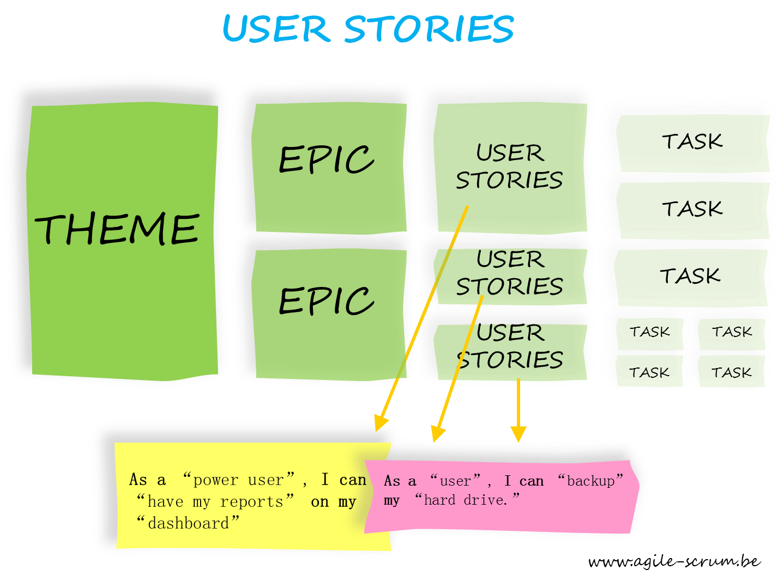
Requirements Specifications
Can come in different forms
Introduction to the Document
1.1 Purpose of the Product
1.2 Scope of the Product
1.3 Acronyms, Abbreviations, Definitions
1.4 References
1.5 Outline of the rest of the SRS
General Description of Product
2.1 Context of Product
2.2 Product Functions
2.3 User Characteristics
2.4 Constraints
2.5 Assumptions and Dependencies
Specific Requirements
3.1 External Interface Requirements
3.1.1 User Interfaces
3.1.2 Hardware Interfaces
3.1.3 Software Interfaces
3.1.4 Communications Interfaces
3.2 Functional Requirements
3.2.1 Class 1
3.2.2 Class 2
…
3.3 Performance Requirements
3.4 Design Constraints
3.5 Quality Requirements
3.6 Other Requirements
Appendices

Slide 13
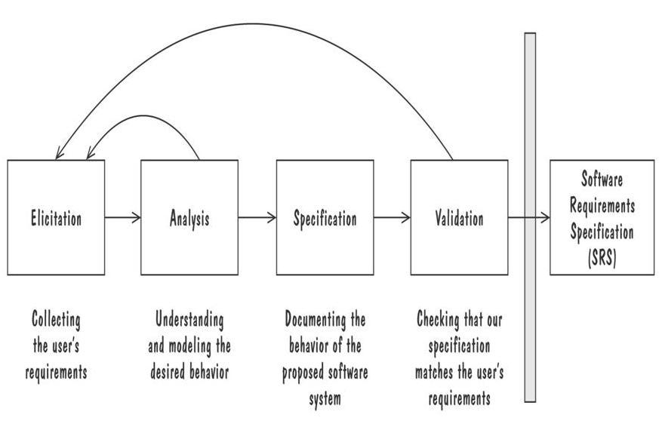
Requirement Process
Creating Software Requirements Specifications

Slide 14
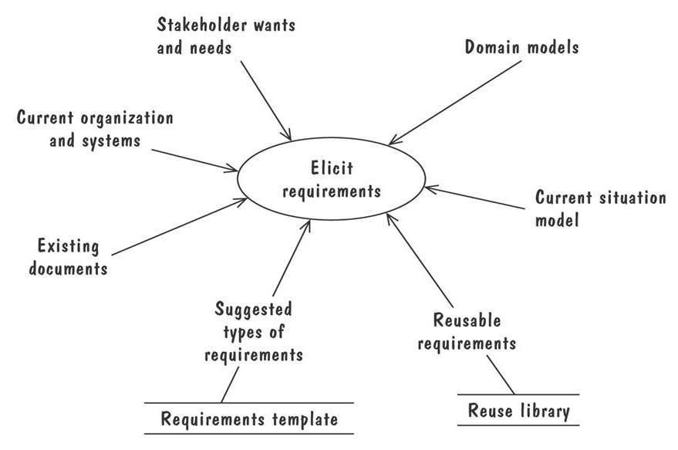
Requirement Elicitation
Requirement Process
Customers do not always understand what their needs and problems are
It is important to discuss the requirements with everyone who has a stake in the system
Different Stakeholders are:
Clients: pay for the software to be developed
Customers: buy the software after it is developed
Users: use the system
Domain experts: familiar with the problem that the software must automate
Market Researchers: conduct surveys to determine future trends and potential customers
Lawyers or auditors: familiar with government, safety, or legal requirements
Software engineers or other technology experts

Slide 15
For testing, you need to understand the perspectives of all stakeholder. Be able to put yourself in their shoes to analyze, design, optimize, and priortize your testing
Requirement Process
Ofcourse, quality is a shared responsibility. So you are not alone. However, the more you can cover and understand the better you will be at your job. The Key is communication and asking questions.

Slide 16
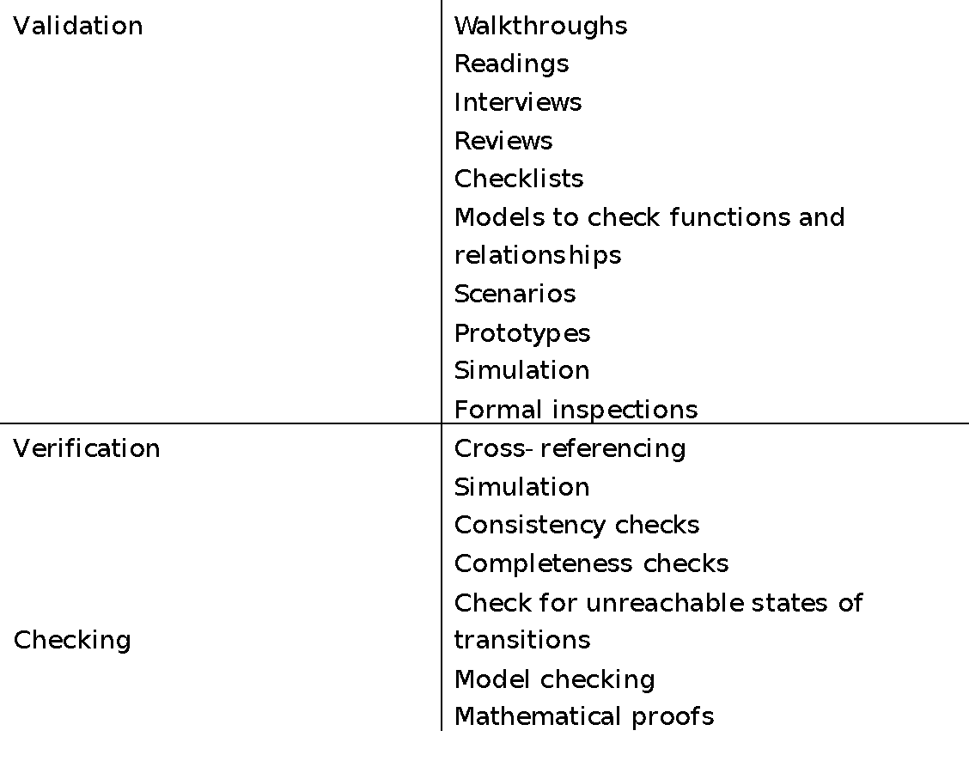
How to test the requirements
Testing Requirements
Validate to check if user requirements are covered
Verification to check if conforms to other documents
Static Testing: Testing a software without running it

Slide 17
Testing Requirements
Testing Requirements
First review it from a high level to identify large fundamental problems, oversights, and omissions (more like research than testing)
Second perform low-Level specification test
Complete
Accurate
Precise, unambiguous and clear
Consistent
Relevant
Feasible
Code Free
Testable

Slide 18
Specifications Terminology Checklist
Testing Requirements
Words that often signify mistake with respect to above specified attributes
Always ,Every, All, None ,Never
Certainly ,Therefore , Clearly, Obviously , Evidently
Some , Sometimes , Often , Usually , Ordinarily , Customarily , Most , Mostly
Etc. and so forth and so on , Such as
Good , Fast ,Cheap , Efficient , Small ,Stable
Handled , Processed , Rejected , Skipped , Eliminated
If..then missing else

Slide 19
Exercise
Exercise
You are building a software solution that will assist an Instructor to evaluate class participation of students. It has a feature of face recognition. Using face recognition and some AI it can identify students activities in class. It has following features
Lecture schedule
Teacher can define lecture schedule
It automatically starts tracking activities when the session starts
It stops tracking activities when the session stops
Attendance
It automatically identifies and records if a student is present in the class
It records all the entry and exit times of each student (considering when student leaves and enters during the class)
It will mark students present/late/absent based on following rules
Mark present if the student came in class within first 10 mins and is present more than 80%
Mark late if the student came in class after 10 mins and is present more than 80%
Mark absent if the total time in class is less than 80%
Class Activity
It can detect students taking part in question/answers during the lecture. It detects following
If someone asks a question
If someone responds to question from instructor
If someone comes over the board and explains/presents something
Teacher, can assign marks to each activity as its performed through an option available to teachers in their hand-held device
Identify a few questions

Slide 20
Requirements as Test basis

Slide 21
Requirement-Based Testing
Requirement as Test Basis
Requirements specify expected behavior
Test case can be designed based on Requirement Specification document
All requirement documents used to create test cases are called Test Basis
Black-box test design techniques can be applied to cover different aspects of test Coverage
Requirement Test Coverage
Defined by the percentage of requirement items addressed by designed tests
Coverage of all requirement does not mean complete system test coverage
Means identified requirement has been addressed
Identify Risk associated with each requirement and apply Risk-based Testing Technique

Slide 22
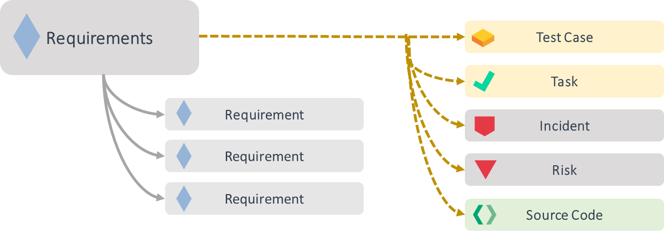
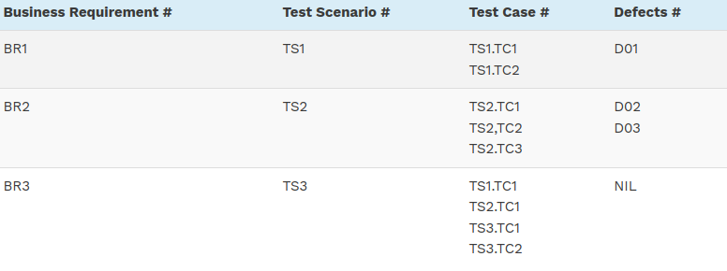
Mapping leads to Traceability
Traceability
Traceability Matrix is a document that correlates any two-baseline documents that require a many-to-many relationship to check the completeness of the relationship.

Slide 23
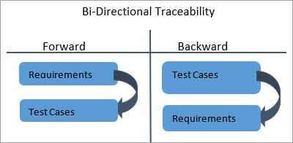
Traceability
Forward and Backward Traceability

Slide 24
Advantages of Requirement Traceability Matrix
Traceability
The build developed and tested has the required functionality which meets the ‘Customers’/ ‘Users’ needs and expectations
It confirms 100% test coverage
It shows the overall defects or execution status with a focus on business requirements
It helps in analyzing or estimating the impact on the QA team’s work with respect to revisiting or re-working on the test cases

Slide 25
Testing Levels, Types, and Methodologies

Slide 26
Testing Levels
Testing Levels
Unit Testing
focuses on components that are separately testable
Test Basis Examples
Detailed design
Code
Data model
Component specifications
Integration Testing
focuses on interactions between components or systems
Test Basis Examples
Software and system design
Sequence diagrams
Interface and communication protocol specifications
Architecture at component or system level
Workflows

Slide 27
Testing Levels
Testing Levels
System Testing
focuses on the behavior and capabilities of a whole system or product, often considering the end-to-end tasks the system can perform and the non-functional behaviors it exhibits while performing those tasks
Test Basis Examples
System and software requirement specifications (functional and non-functional)
Risk analysis reports
Epics and user stories
System and user manuals

Slide 28
Testing Levels
Testing Levels
Acceptance Testing
Acceptance testing may produce information to assess the system’s readiness for deployment and use by the customer (end-user)
Alpha and beta testing
Alpha and beta testing are typically used by developers of commercial off-the-shelf (COTS) software who want to get feedback from potential or existing users, customers, and/or operators before the software product is put on the market

Slide 29
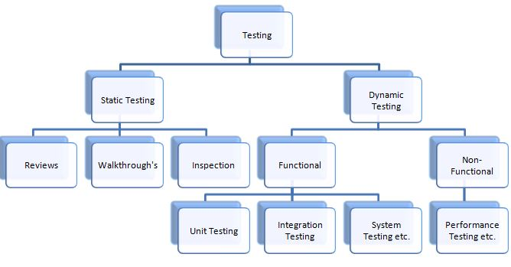
Static and Dynamic Testing
Static & Dynamic Testing
Static Testing – testing a software without running it
Used to test the work products like plan, requirements, architecture and design documents, code, test plan, test cases, user guides, contracts, schedules, budget, etc
Dynamic Testing – running the program
Used to test the working software/system

Slide 30
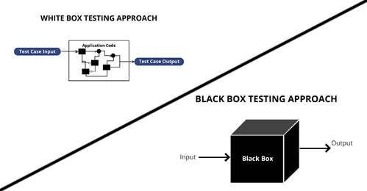
White box and Black box Testing
Testing Types
Black box testing – what is supposed to be done 🡪 functionality
does not concern how the software
accomplish the work
outside view of the software
input-output relationships
White (clear) box testing – how the software does its job
look into code details

Slide 31
Change-related Testing
Testing Types
Confirmation Testing
Testing should be done to confirm that the changes have corrected the defect or implemented the functionality correctly
Regression Testing
Testing should be done to confirm that the changes have not caused any unforeseen adverse consequences

Slide 32
Smoke Test & Sanity Testing
Testing Types

Slide 33
All testing types can be applied to all testing levels
Testing Levels and Types

Slide 34
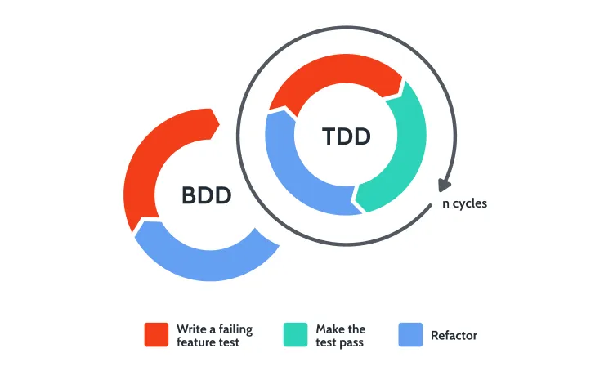
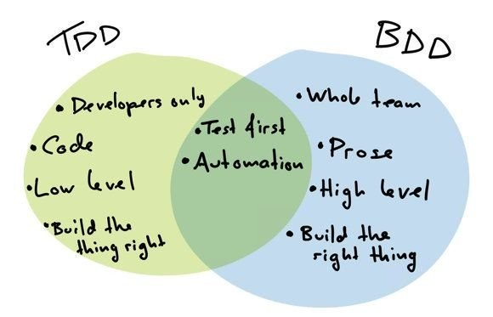
Test First Development Methodologies
Behavior Drive Development and Test Driven Development

Slide 35
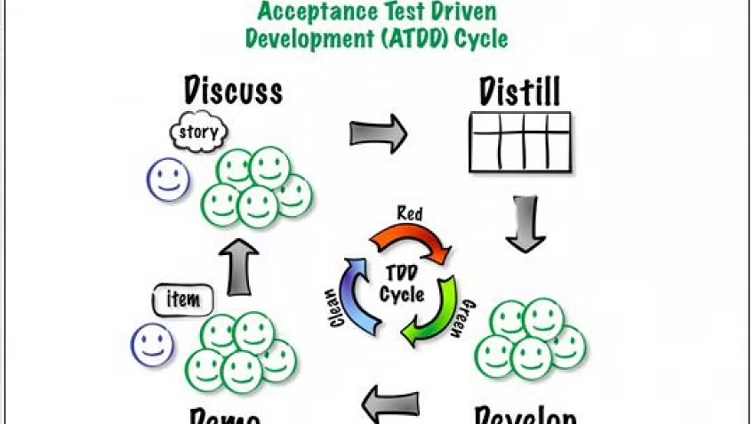
Test First Development Methodologies
Acceptance Test-Driven Development
Defines acceptance criteria and tests during the creation of user stories. ATDD is a technique used WITHIN BDD. They are not one and the same.

Slide 36
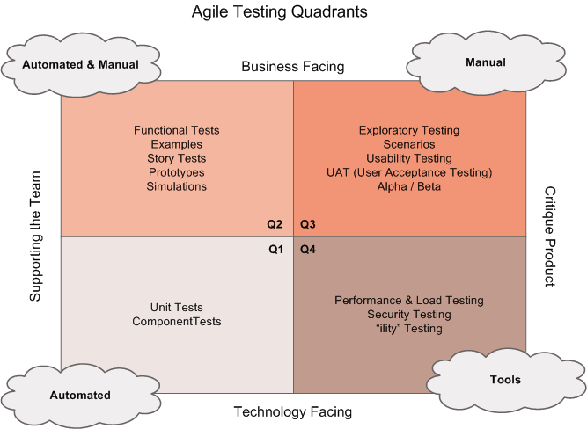
Test First Development Methodologies
Applying testing in Agile

Slide 37
Reading Break and Exercise

Slide 38
Reading
Reading Break and Exercise
https://istqb-main-web-prod.s3.amazonaws.com/media/documents/ISTQB-CTFL_Syllabus_2018_v3.1.1.pdf
Chapter 2
https://istqb-main-web-prod.s3.amazonaws.com/media/documents/ISTQB-CTFL-AT_Syllabus_v1.0.pdf
Chapter 3.1

Slide 39
Lab Exercise

Slide 40
Getting Started
Lab Exercise
Continue with the same group
Continue with same notion workspace
Continue with the same notion template from previous lab

Slide 41
Read through the requirements and create these requirements in Notion
Lab Exercise
Continue to use existing notion workspace and create new requirements in Requirement document already important in 1 lab assignment
https://wax-waxflower-357.notion.site/Sample-Test-Case-Repository-a2e13fdd19dc418f9fdb62200bd239e0
Don't just copy-paste these requirements to the notion directly. Group or divide these requirements as required to make them more manageable in notion.
Properly make use of features and tags fields to associate correct values, e.g.
Features: Template Manager, Template Creation, Template Use
Tags: Functional, Security, Performance, UI/UX
Tags; Critical, high, medium, low based on risk analysis
In each requirement add comments if you have any questions/concerns regarding the requirement and add tag “Have Questions”

Slide 42
Write Test Case
Lab Exercise
Use the same test case repository table already available as per the previous day assignment
Properly tags test cases as per
Related feature, component, Smoke (where required)
Properly update their Risk related fields including (Severity, Priority, Risk Type, Risk Probability)

Slide 43
Reading Break and Exercise

Slide 44
Reading
Reading Break and Exercise
https://www.geeksforgeeks.org/software-engineering-requirements-elicitation/
https://levelup.gitconnected.com/guide-to-testing-requirements-main-criteria-features-and-risks-379c5a72a657
https://www.softwaretestinghelp.com/how-to-test-software-requirements-specification-srs/
https://www.guru99.com/traceability-matrix.html
https://www.inflectra.com/Ideas/Topic/Requirements-Traceability.aspx

Slide 45
Exercise
Reading Break and Exercise
You are building a software solution that will assist an Instructor to evaluate class participation of students. It has a feature of face recognition. Using face recognition and some AI it can identify students activities in class. It has following features
Lecture schedule
Teacher can define lecture schedule
It automatically starts tracking activities when the session starts
It stops tracking activities when the session stops
Attendance
It automatically identifies and records if a student is present in the class
It records all the entry and exit times of each student (considering when student leaves and enters during the class)
It will mark students present/late/absent based on following rules
Mark present if the student came in class within first 10 mins and is present more than 80%
Mark late if the student came in class after 10 mins and is present more than 80%
Mark absent if the total time in class is less than 80%
Class Activity
It can detect students taking part in question/answers during the lecture. It detects following
If someone asks a question
If someone responds to question from instructor
If someone comes over the board and explains/presents something
Teacher, can assign marks to each activity as its performed through an option available to teachers in their hand-held device
Assign ID to each requirement
Write Test Cases for a few requirements
Create Traceability Matrix

Slide 46
Q&A
Instructor Notes

